Slide 1
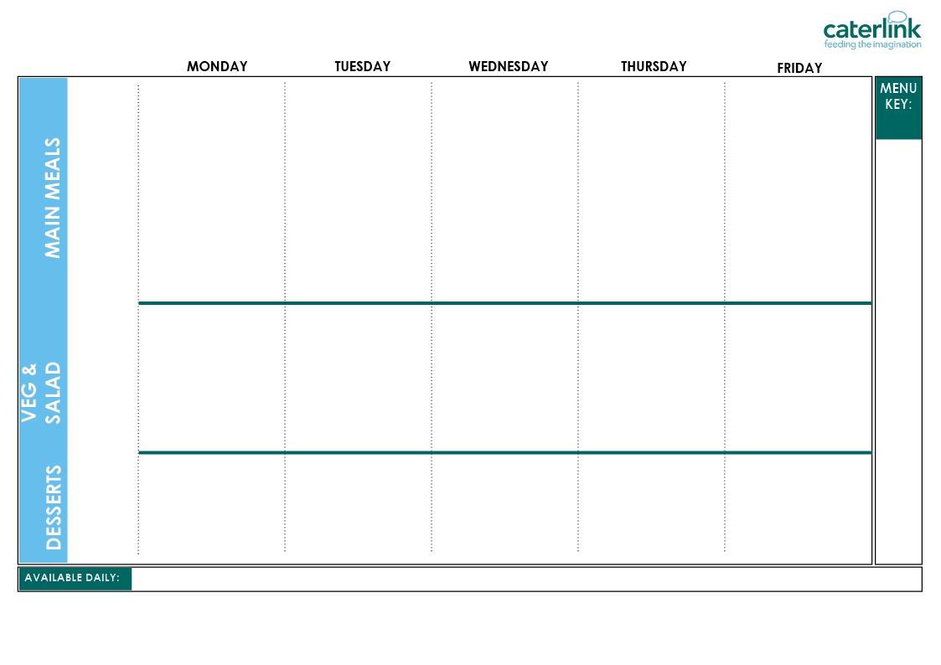








WEEK 1 CAMDEN SPRING SUMMER MENU 2026
Planet Friendly Day
Option One
Option Two
Vegetables
Salad Bar
Dessert
Classic Macaroni Cheese with Sweetcorn Bread (V) | Smokey Bean Burger with Paprika Wedges (VE) | Lentil Wellington, Roast Potatoes & Gravy (VE) | Chef’s Special Chickpea Curry with Rice (VE) | Cheesy Broccoli Frittata with New Potatoes (V)
Mild Mexican Chilli with Rice and Sweetcorn Bread (VE) | Chicken 50% Enchilada Bake with Paprika Wedges | Roast Chicken, Stuffing, Roast Potatoes & Gravy | Hearty Beef and Lentil Bolognaise with Spaghetti | Fishfingers or Salmon Fishfingers with Chips & Tomato Sauce
Courgette (VE) Butternut Squash (VE) | Green Beans (VE) Carrots (VE) | Cabbage (VE) Broccoli (VE) | Leeks (VE) Cauliflower (VE) | Peas (VE) Sweetcorn (VE)
Roasted Vegetable and Lentil Salad (VE) Carrot Sticks (VE) Mixed Lettuce (VE) Diced Peppers (VE) Sweetcorn (VE) | Sweet Potato and Coriander Salad (VE) Tomatoes (VE) Lettuce (VE) Cucumber (VE) Coleslaw (V) | Rainbow Slaw (VE) Green Bean Salad (VE) Cucumber (VE) Tabbouleh Salad (VE) Carrot Sticks (VE) | Beetroot and Orange Salad (VE) Tomato Pasta (VE) Sweetcorn (VE) Lettuce (VE) Tomatoes (VE) | Lettuce (VE) Pepper Sticks (VE) BBQ Noodle Salad (V) Grated Carrot (VE) Beetroot (VE)
Yoghurt (V) and Tinned Peaches (VE) | Yoghurt (V) and Fresh Fruit (VE) | Yoghurt (V) and Fresh Fruit – Honeydew Melon, Orange and Apple (VE) | Pear and Raisin Sponge (V) | Strawberry Jelly with Mandarins (VE)
Whole
grain
Plant
based
Added plant protein
Chef’s Special
Local
Red Tractor
Meat
Local, Seasonal Fruit & Veg
Freshly cooked jacket potatoes with a choice of fillings (V/VE) - A choice of flavoured breads freshly baked on site daily (VE) - Daily salad selection (V/VE) – Fresh Fruit (VE) – Natural Yoghurt (V/VE) - Drinking Milk (V/VE)
(V) Vegetarian (VE) Vegan
If you would like to know about particular allergens in foods, please ask a member of the catering team for information. If your child has a school lunch and has a food allergy or intolerance you will be asked to complete a form to ensure we have the necessary information to cater for your child. We use a large variety of ingredients in the preparation of our meals and due to the nature of our kitchens it is not possible to completely remove the risk of allergen cross contact.

Slide 2
WEEK 2 CAMDEN SPRING SUMMER MENU 2026
Planet Friendly Day
Option One
Option Two
Vegetables
Salad Bar
Dessert
Spaghetti & Hearty Planet Friendly Balls with Tomato and Herb Bread (VE) | Summer Butterbean Treasure Chest Risotto (VE) | Golden Roasted Quorn, New Potatoes & Gravy (VE) | Greek Spinach & Cheese Whirl with Herby Rice, Tzatziki & Salad (V) | Wholemeal Vegetable Pasta Bake (VE)
Classic Cheese & Tomato Pizza with Summer Mixed Salad (V) | Beef Chilli with Rice & Sweetcorn & Cucumber Salsa | Chicken Sausage, New Potatoes & Gravy | Greek Chicken Pitta with Herby Rice, Tzatziki & Salad | Battered Fish with Chips & Tomato Sauce
Carrots (VE) Spring Greens (VE) | Sweetcorn (VE) Broccoli (VE) | Roasted Summer Vegetables(VE) Peas (VE) | Green Beans (VE) Cauliflower (VE) | Peas (VE) Coleslaw(VE)
Mixed Bean Salad (VE) Lettuce (VE) Tomato Pasta (VE) Cucumber Slices (VE) Beetroot (VE) | Grated Carrot (VE) Cucumber Sticks (VE) Roasted Vegetable and Lentil Salad (VE) Tomato Salsa (VE) Beetroot (VE) | Grated Carrot and Raisin Salad (VE) Coleslaw (V) Green Bean Salad (VE) Diced Pepper (VE) Cucumber (VE) | Carrot Sticks (VE) Rainbow Slaw (VE) Iceberg Lettuce (VE) Tomatoes (VE) Couscous Salad (VE) | Sweet Potato Power Salad (VE) Mixed Lettuce (VE) Carrot Sticks (VE) Pepper Sticks (VE) Sweetcorn (VE)
Yoghurt (V) and Fresh Fruit – Apple, Watermelon and Pineapple (VE) | Peaches (VE) & Ice Cream (V) | Yoghurt (V) and Fresh Fruit – Pineapple, Orange and Apple (VE) | Apple Sponge (V) | Yoghurt (V) and Fresh Fruit (VE)
Whole
grain
Plant
based
Added plant protein
Chef’s Special
Local
Red Tractor
Meat
Local, Seasonal Fruit & Veg
Freshly cooked jacket potatoes with a choice of fillings (V/VE) - A choice of flavoured breads freshly baked on site daily (VE) - Daily salad selection (V/VE) – Fresh Fruit (VE) – Natural Yoghurt (V/VE) - Drinking Milk (V/VE)
(V) Vegetarian (VE) Vegan
If you would like to know about particular allergens in foods, please ask a member of the catering team for information. If your child has a school lunch and has a food allergy or intolerance you will be asked to complete a form to ensure we have the necessary information to cater for your child. We use a large variety of ingredients in the preparation of our meals and due to the nature of our kitchens it is not possible to completely remove the risk of allergen cross contact.

Slide 3
WEEK 3 CAMDEN SPRING SUMMER MENU 2026
Planet Friendly Day
Option One
Option Two
Vegetables
Salad Bar
Dessert
Caribbean bean stew (VE) | Saucy Tomato Pasta (VE) | BBQ Quorn with Potato Wedges and Rainbow Slaw (V) | Luscious Lentil & Sweet Potato Curry with Rice and Turmeric Bread (VE) | Savoury Summer Chickpea &Vegetable hotpot (VE)
Chinese Rainbow Noodles (V) | Beef Lasagne with Garlic Bread | Peri Peri Chicken with Potato Wedges and Rainbow Slaw | Chicken Korma with Rice and Turmeric Bread | Fishfingers with Chips & Tomato Sauce
Carrots (VE) Peppers (VE) | Vegetable Medley (VE) Broccoli (VE) | Sweetcorn (VE) Peas (VE) | Green Beans (VE) Red Cabbage (VE) | Baked Beans (VE) Peas (VE)
Rainbow Slaw (VE) Beetroot (VE) Butternut Squash (VE) Mixed Lettuce (VE) Cucumber Sticks (VE) | Mixed Bean Salad (VE) Beetroot (VE) Iceberg Lettuce (VE) Tomatoes (VE) Couscous Salad (VE) | Tomatoes (VE) Cucumber Slices(VE) Grated Carrot (VE) Green Bean Salad(VE) Vegetable Pasta Salad (VE) | Sweet Potato Salad (VE) Carrot Sticks (VE) Diced Pepper (VE) Sweetcorn Salsa (VE) Tomatoes (VE) | Apple and Raisin Salad (V) Coleslaw (V) Grated Carrot (VE) Mixed Lettuce (VE) Pepper Sticks (VE)
Yoghurt (V) and Fresh Fruit – Banana, Pineapple and Grapes (VE) | Strawberry and Apple Crumble (VE) with Custard (V) | Yoghurt (V) and Fresh Fruit - Banana, Watermelon and Apple (VE) | Yoghurt (V) and Fresh Fruit (VE) | Pineapple Upside Down Cake (V)
Whole
grain
Plant
based
Added plant protein
Chef’s Special
Local
Red Tractor
Meat
Local, Seasonal Fruit & Veg
Freshly cooked jacket potatoes with a choice of fillings (V/VE) - A choice of flavoured breads freshly baked on site daily (VE) - Daily salad selection (V/VE) – Fresh Fruit (VE) – Natural Yoghurt (V/VE) - Drinking Milk (V/VE)
(V) Vegetarian (VE) Vegan
If you would like to know about particular allergens in foods, please ask a member of the catering team for information. If your child has a school lunch and has a food allergy or intolerance you will be asked to complete a form to ensure we have the necessary information to cater for your child. We use a large variety of ingredients in the preparation of our meals and due to the nature of our kitchens it is not possible to completely remove the risk of allergen cross contact.

